Slide 1
Digital Twins in IoT: Bridging the Physical and Digital Worlds
By Sahifa Syed

Slide 2
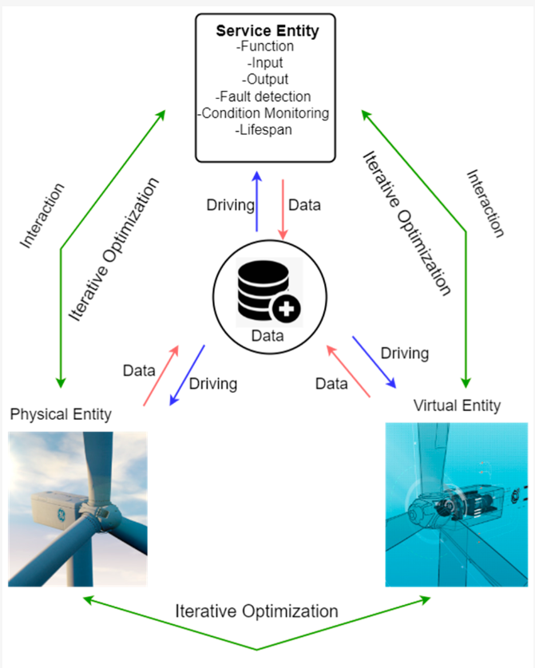
Introduction to Digital Twins
Definition:
- A digital twin is a dynamic digital replica of a physical object, process or system.
- It Integrates real-time sensor data through IoT.
Origin:
- Emerged from NASA in the early 2000s for spacecraft simulations.
- Adopted across industries: healthcare, construction, transportation, manufacturing.
(Yaacoub et al., 2023; Wang et al., 2023)

Slide 3
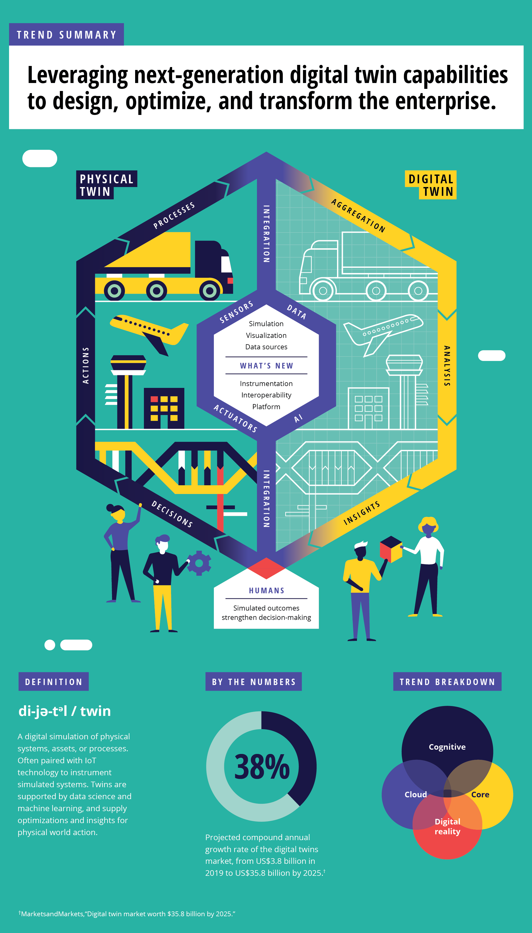
Why Digital Twins Matter in IoT
Adds meaning to raw sensor data.
Enables predictive analytics and real-time simulations.
Optimizes maintenance, improves efficiency across various sectors.
(IoT Analytics, 2023) (AWS, 2023) (Adreani et al., 2023)

Slide 4
Architecture of a Digital Twin in IoT
Physical Layer
Sensors and devices
Communication Layer
MQTT, 5G, WiFi
Data Processing Layer
Edge and cloud computing
Virtual Model Layer
Real-time digital system
Application Layer
Dashboards, alerts, user controls
(Wang et al., 2023; IEEE, 2023)

Slide 5
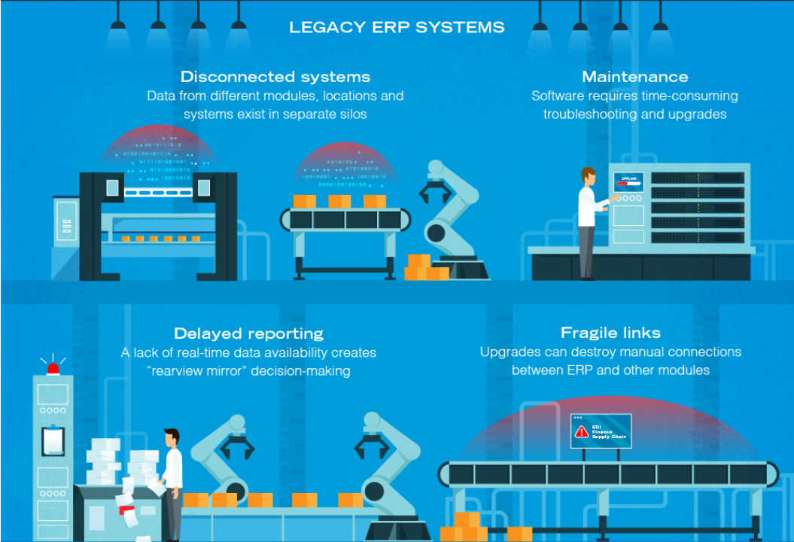
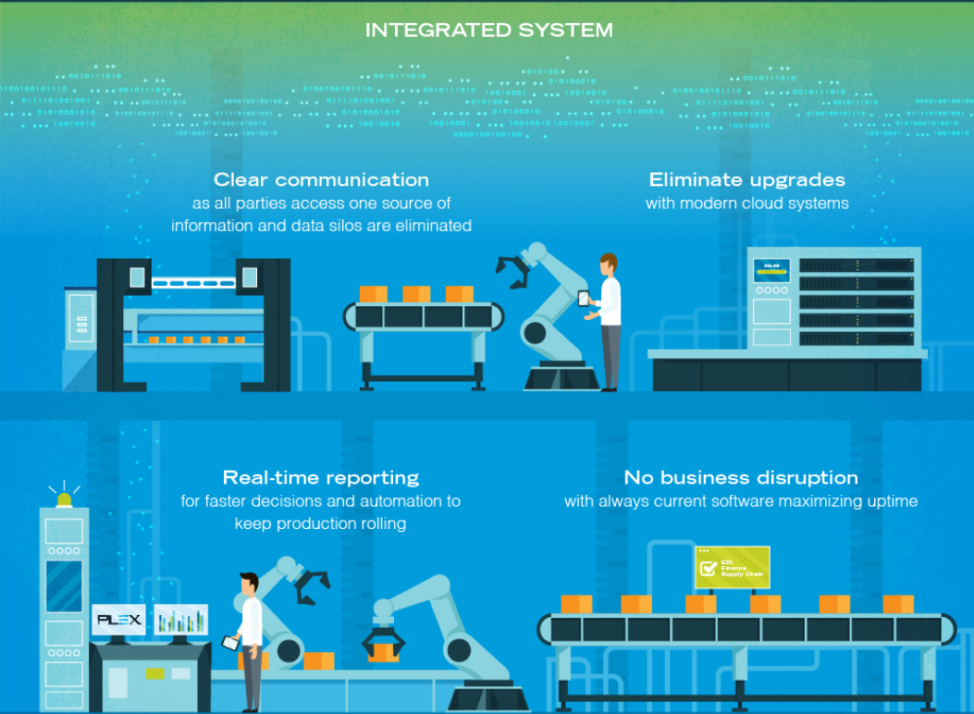
Case Study – Smart Manufacturing
Real-time IoT sensors track equipment performance on production lines
Digital twins simulate workflows, enabling early fault detection
AI-integrated models identify vibration or heat anomalies before failure
Result: downtime is minimized, lifespan extended, and efficiency improved
(Yaacoub et al., 2023)

Slide 6

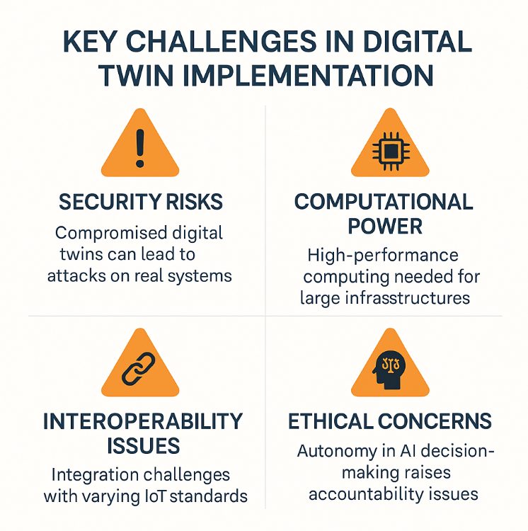
Challenges of Digital Twins in IoT
Security Risks : Attacks on real systems.
Computation demand : Needed for large infrastructure.
Device interoperability : Integration challenges with varying IoT standards.
Ethical concerns : With AI-driven decisions.
(SpringerLink, 2023) (Lipsa, Dash and Cengiz, 2024) (Reuters, 2024)

Slide 7

Conclusion & Career Relevance
Digital twins transform static environments into intelligent, self-adaptive systems.
Career Relevance:
- Importance for cybersecurity and digital forensics students.
- Need for secure, tamper-proof designs as digital twins integrate into critical infrastructure.
- Future forensic analysis opportunities tracing virtual anomalies to physical counterparts.
(Sciullo et al., 2023)

Slide 8
References
Adreani, L., Bellini, P., Fanfani, M., Nesi, P. and Pantaleo, G., 2023. Smart City Digital Twin Framework for Real-Time Multi-Data Integration and Wide Public Distribution. arXiv preprint arXiv:2309.13394. Available at: https://arxiv.org/abs/2309.13394 [Accessed 22 Mar. 2025].
AWS, 2023. 2023 year in review: digital twins on AWS for agile and resilient operations. [online] AWS IoT Blog. Available at: https://aws.amazon.com/blogs/iot/ [Accessed 23 Mar. 2025].
IEEE, 2023. Advances in Digital Twin Technology. [online] IEEE Innovation Spotlight. Available at: https://innovate.ieee.org/innovation-spotlight/digital-twin-technology/ [Accessed 23 Mar. 2025].
IoT Analytics, 2023. 6 Digital Twin Applications and Their Benefits. [online] IoT Analytics. Available at: https://iot-analytics.com/6-main-digital-twin-applications-and-their-benefits/ [Accessed 25 Mar. 2025].
Lipsa, S., Dash, R.K. and Cengiz, K., 2024. Mitigating Security Threats for Digital Twin Platform: A Systematic Review with Future Scope and Research Challenges. International Journal of Electronics and Communication Systems (IJECS), 4(1). Available at: https://ejournal.radenintan.ac.id/index.php/IJECS/article/view/22279 [Accessed 25 Mar. 2025].

Slide 9
References
Reuters, 2024. Avoiding growing pains in the development and use of digital twins. [online] Reuters. Available at: https://www.reuters.com/legal/legalindustry/avoiding-growing-pains-development-use-digital-twins-2024-08-20/ [Accessed 27 Mar. 2025].
Sciullo, L., De Marchi, A., Trotta, A., Montori, F., Bononi, L. and Di Felice, M., 2023. Relativistic Digital Twin: Bringing the IoT to the Future. arXiv preprint arXiv:2301.07390. Available at: https://arxiv.org/abs/2301.07390 [Accessed 30 Mar. 2025].
SpringerLink, 2023. Digital Twins for IoT Security Management. In: Advances in Intelligent Systems and Computing. [online] Available at: https://link.springer.com/chapter/10.1007/978-3-031-37586-6_9 [Accessed 07 Apr. 2025].
Wang, Y., Su, Z., Guo, S., Dai, M., Luan, T.H. and Liu, Y., 2023. A Survey on Digital Twins: Architecture, Enabling Technologies, Security and Privacy, and Future Prospects. arXiv preprint arXiv:2301.13350. Available at: https://arxiv.org/abs/2301.13350 [Accessed 09 Apr. 2025].

Slide 10
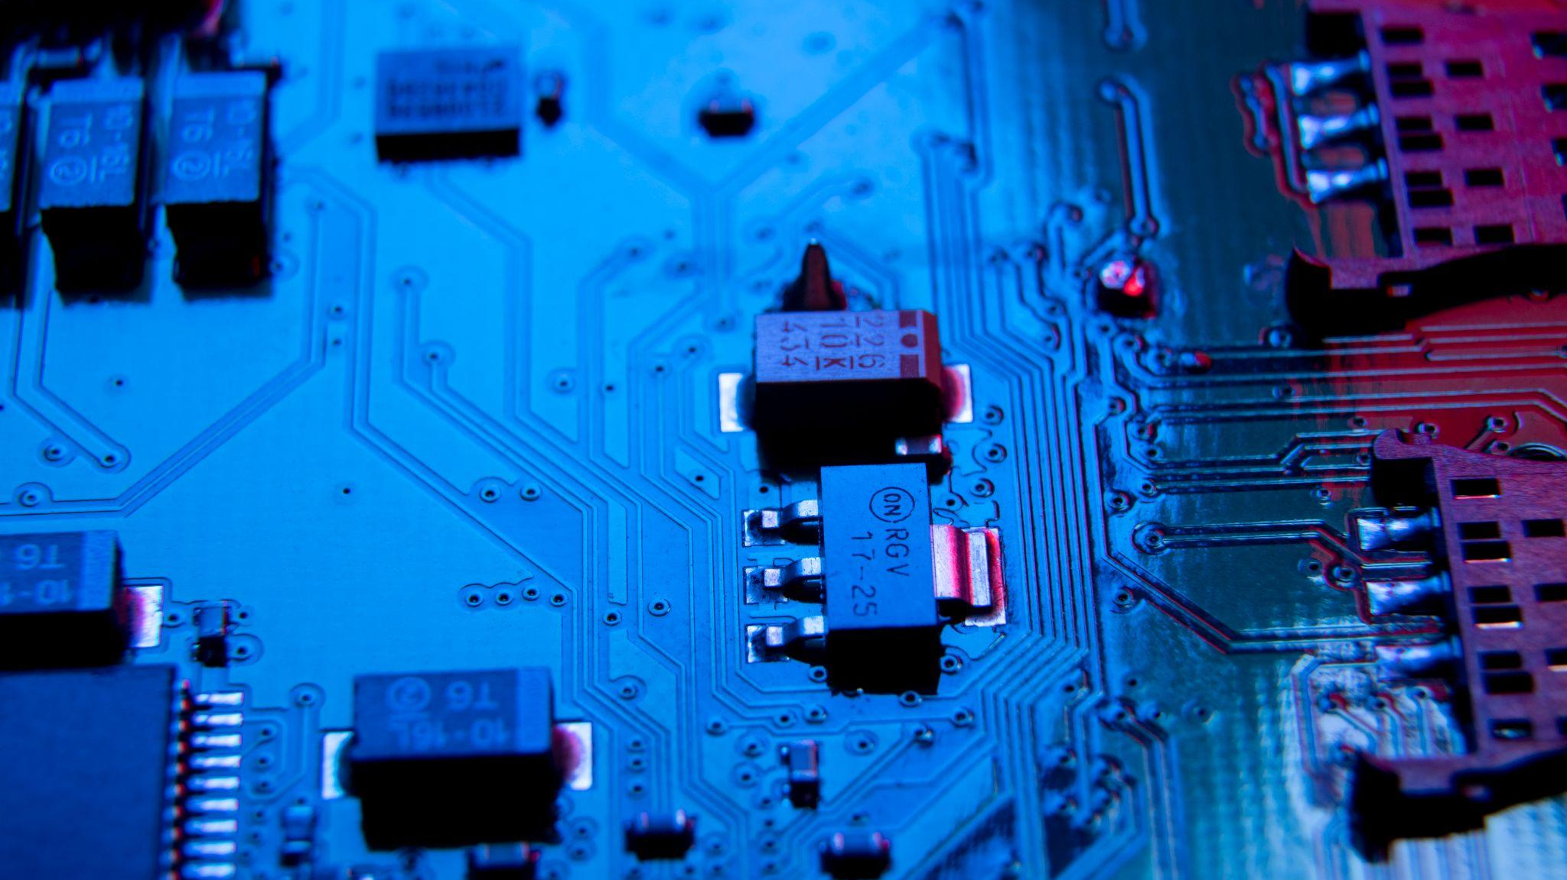
Thank You For Listening ☺

